Slide 1
Girls Flag Football
Capital District Pop Warner
Girls Flag Football spearheaded by Guilderland Pop Warner

Slide 2
Mike Jantzen
Husband
Father of two Girls – Age 15 and 12
Lifelong sports fan
Director of Acute Outpatient Services at local Hospital system.
Just completed 10th year as President of Guilderland Pop Warner
Board Member with Guilderland Girls Softball
12U Travel Softball Manager
Rec Coordinator and Manager
Assistant coach with GPW
Board member for 2 other Not for Profits
Now decided to do this….. Might end in divorce but let’s hope not… I think its very important and I/we need your help.
“Firmly believe that team sport creates character for sustained life success”

Slide 3
Nike and NFL Partner to Grow Girls Flag Football in the US.
$5 million in product to growing flag football within high school athletics.
Unprecedented growth leads National Association of Intercollegiate Athletics to Greenlight Women’s Flag Football to Emerging Sport Status
Nike and NFL- $100,000 in product to state athletic associations that offer girls flag as high school sport!
Six States Sanction High School Flag Football for Girls
(Alaska, Arizona, Florida, Georgia, Nevada and New York)

Slide 4
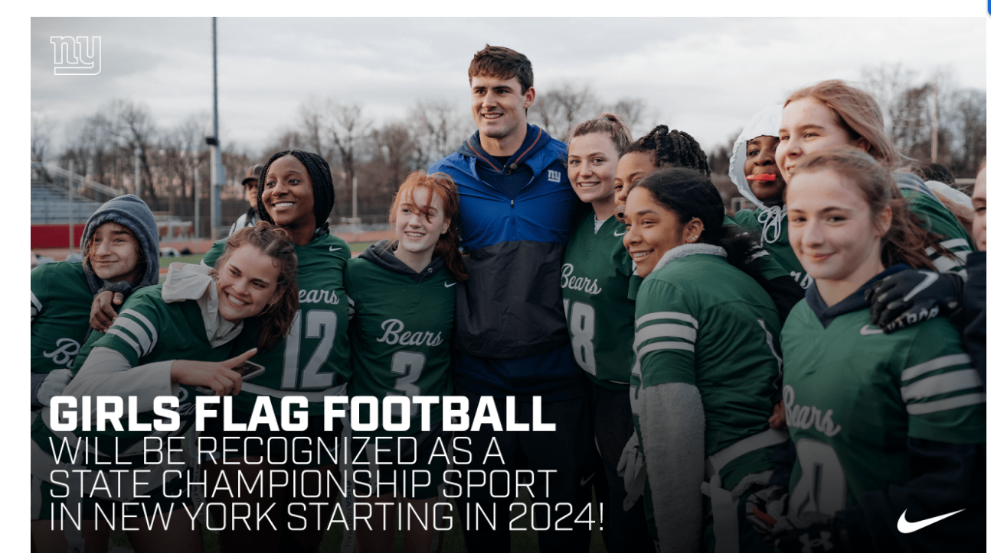
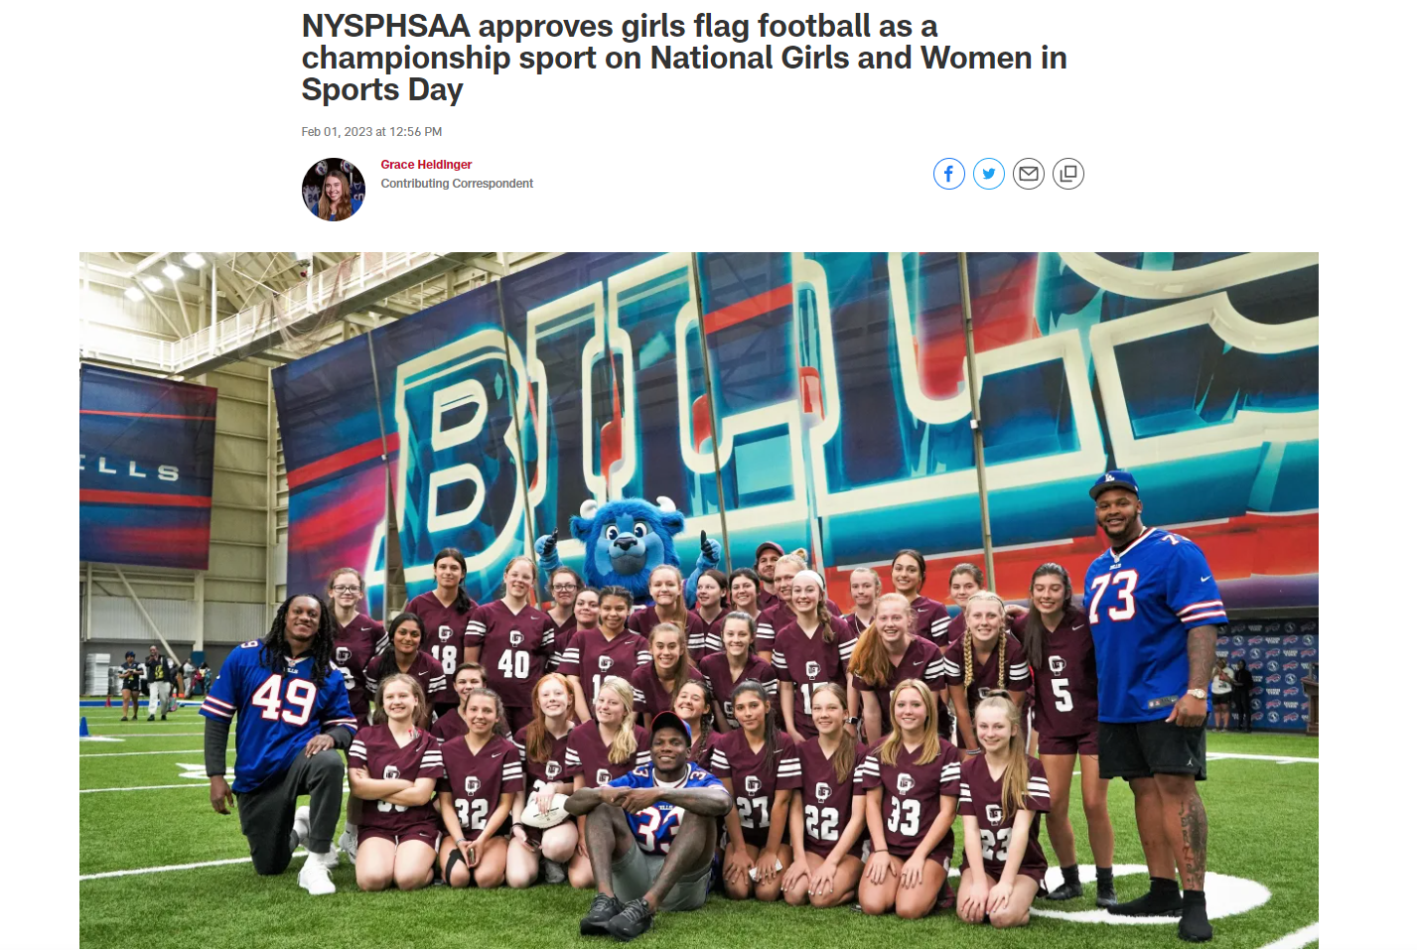
https://www.newyorkjets.com/community/jets-foundation/girls-flag-football

Slide 5
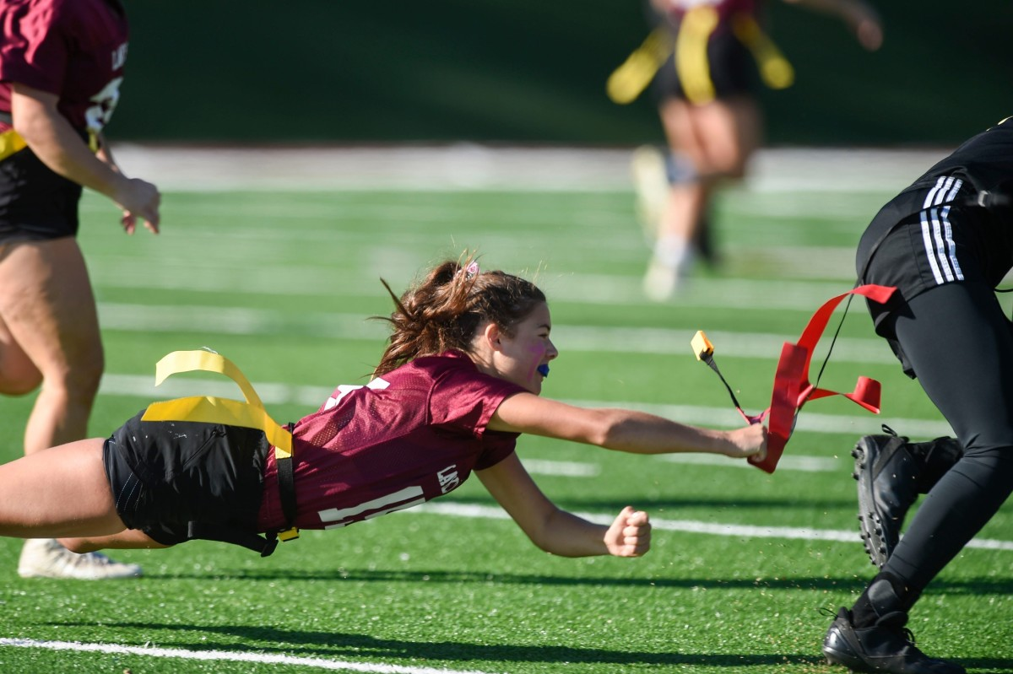
_{A Path to College}
Girls across the country are fueling their passion for flag football and taking their game to the college level. In 2020, women’s flag football became a sanctioned college sport, with 15 National Association of Intercollegiate Athletics (NAIA) universities kicking off their leagues in 2021. The best part? They’re offering scholarships. Learn more about NAIA Women’s Flag Football.

Slide 6
Benefits of PW for Girls programming
Look around the room- programs in several towns
Little Scholars
Stability
Inexpensive
College Scholarships
Mandatory Play requirements
Team structure– aged base
Volunteers and coaches
60%-70% of all NFL players began careers in PW
Background Checks for volunteers
Concussion prevention and awareness
Coaching Education Programs
National Rule Book
Administrative Manuals
Coaching and Adult Code of Conduct
Free Online Rostering program
Competitive and Affordable Insurance
Sponsors

Slide 7
GPW Registration is Open
10U
12U
14U
16U
We’re willing to operate the entire thing to start
We’ll be best with all of you on board.
Open Registration--- if it hits, you have a new team and new promotional opportunities.
If it doesn’t, the kids will be welcome to play in Guilderland.
Our hope is to have at minimum 40 girls come out at each level (4 teams)

Slide 8
What does the season look like
Pop Warner Flag Rules Apply
Subject to Pop Warner paperwork and registration processing.
Coaching Training follows the same tract
Eventual CDPW partnership with NFL Flag for girls. Other PW locations across country have joined for tackle and boys flag.
Pre-season practicing August
Game schedule to start simultaneous with CDPW typical schedule
6-8 week game season
Post season play and Capital District Championship 2023.

Slide 9
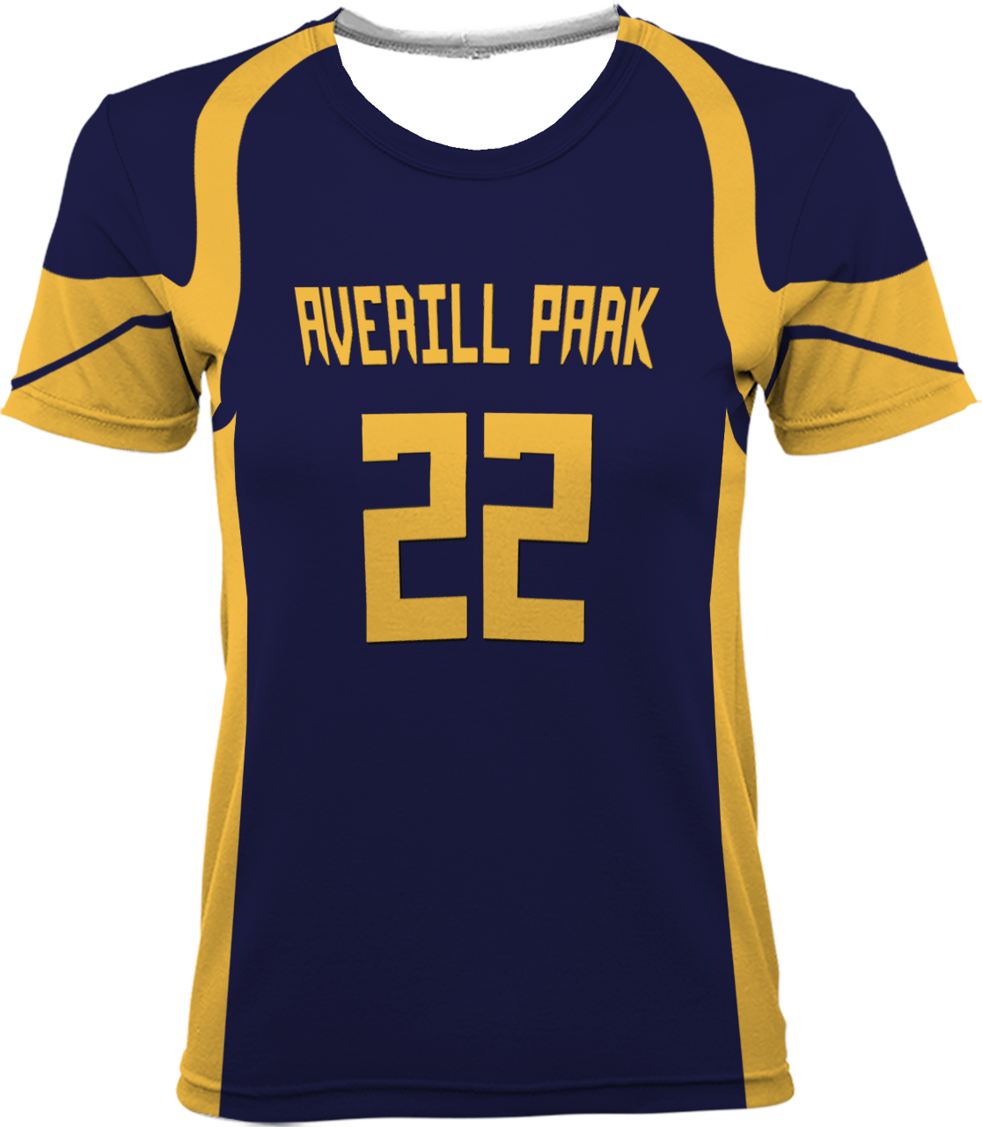
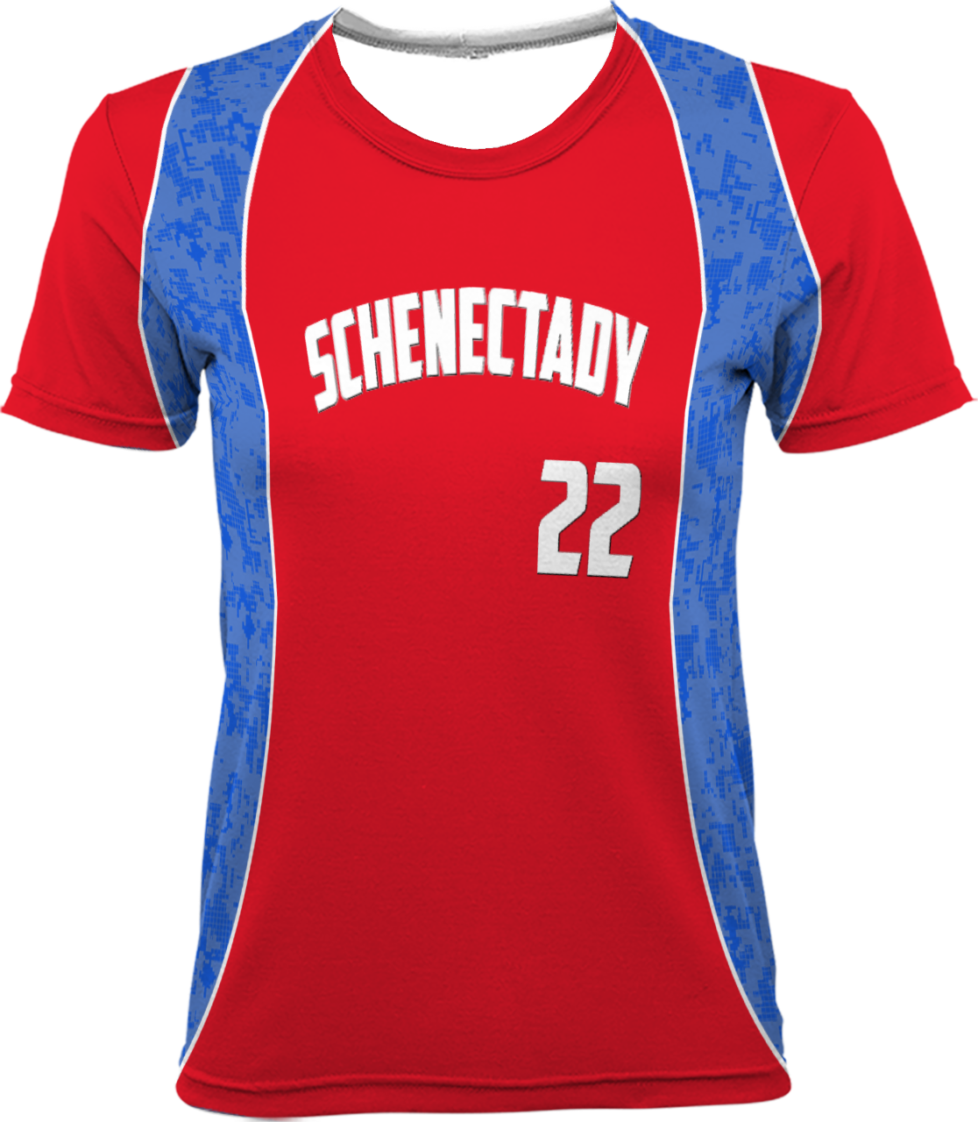
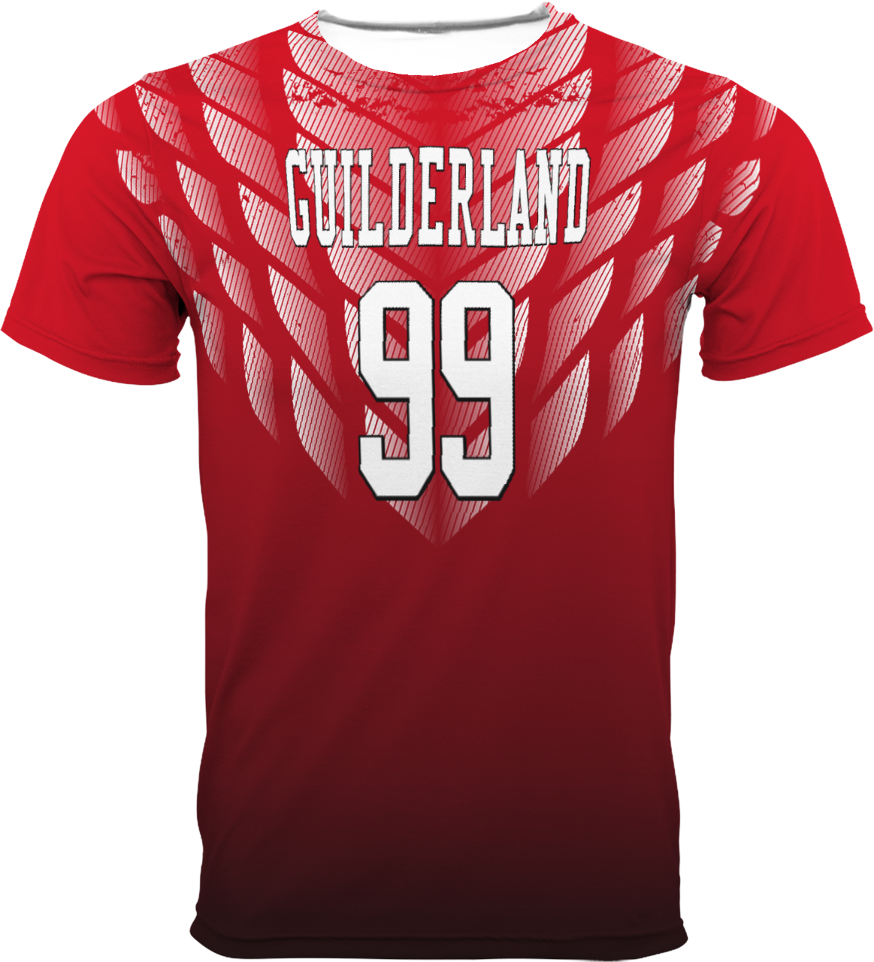
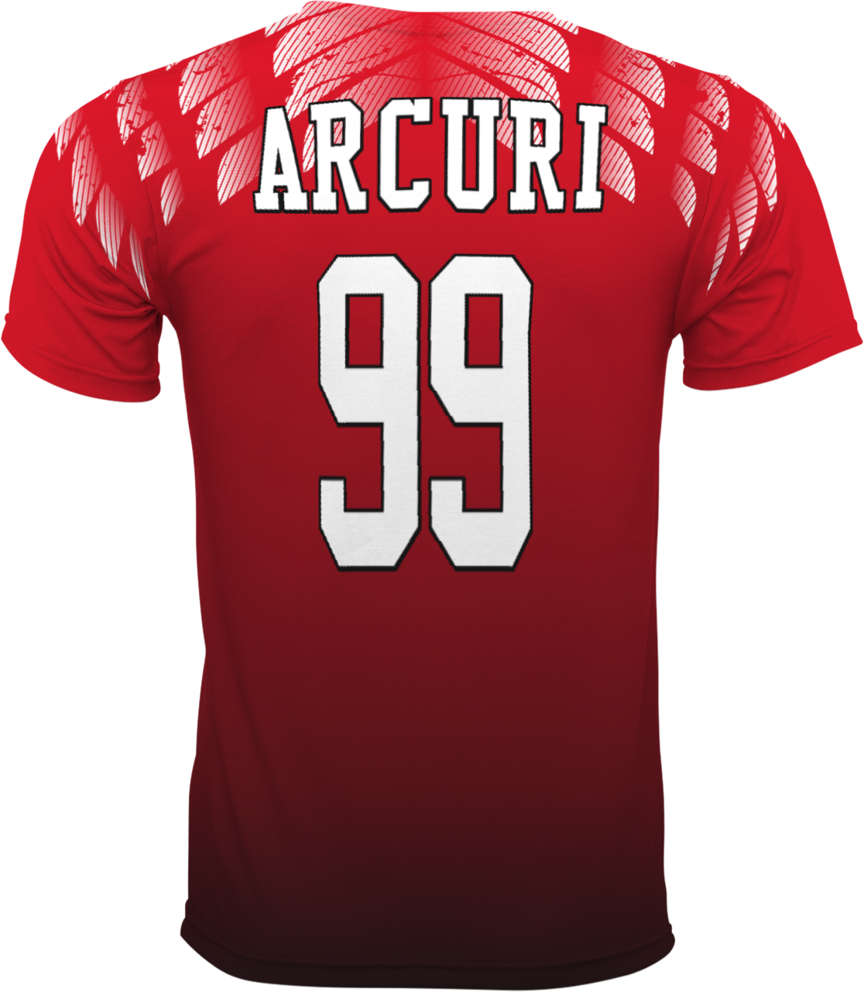
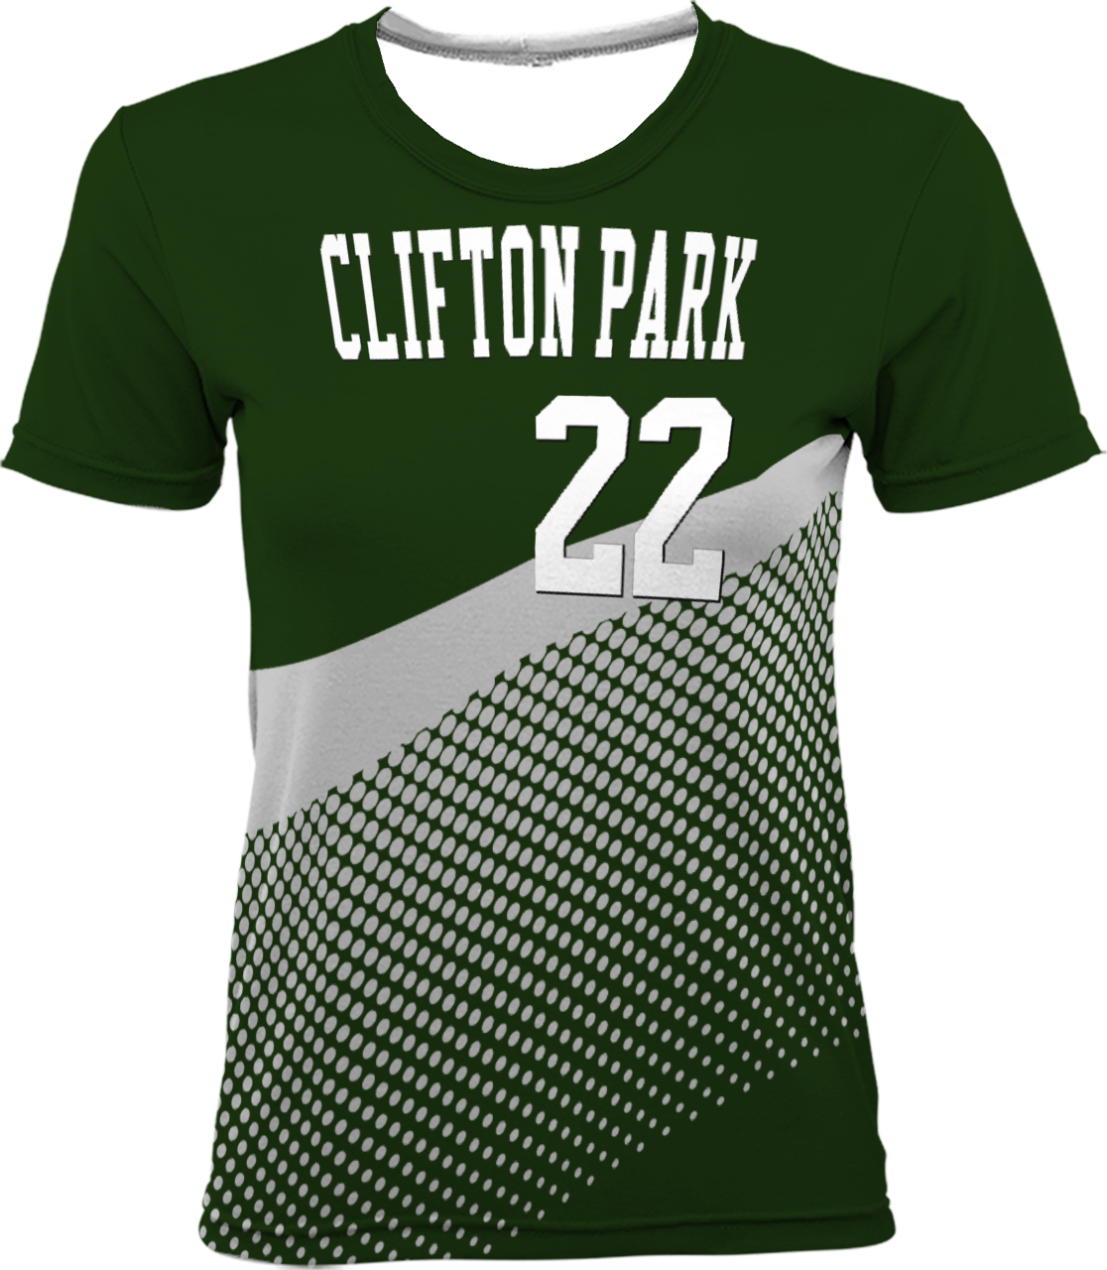

Slide 10
Elite Apparel
Just a few samples of some mock ups for the different Orgs.
Each org would have their specific colors and team name/logo on the jersey
Create a website and allow each team access so they could design their own jersey using templates.
Each Jersey cost roughly $30– fully sublimated and would have names on each if you want at no extra cost.
If entire league were to use elite apparel– and all jerseys were done for every program the price would cut.
Let me know if you’d like to look at the design studio– he can get you the link

Slide 11
What do we need?
Decisions from other associations--- Want GPW to run year 1? Need answer by June.
Information from beyond CDPW--- Will Eastern support moving on beyond local championship or do we stop there in year one?
Connected with NFL Flag--- they’ll endorse our Pop Warner program--- need to know from National relatively quickly if we can operate under their rules or if we must follow Pop Warner. – currently prepping to run under PW rules.
Registration at consistent pricing so kids can be versatile in placement without a need for refunds or increases in dues. $125 early reg/150 after 6.30.23
Everyone to push advertisement!

Slide 12
Thoughts/Questions/Contact Info
Mike Jantzen
mjan0201@hotmail.com
315-868-2510

